Slide 1
Java Tech Sharing
2021.3.1

Slide 2
Agenda
Thread
Lock
Thread Pool

Slide 3
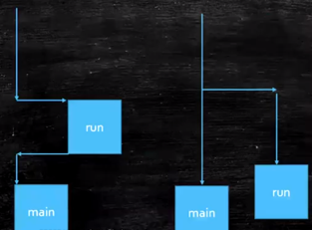
Thread
What is thread?
Wiki : A thread of execution is the smallest sequence of programmed instructions
Different execution paths in the process

Slide 4
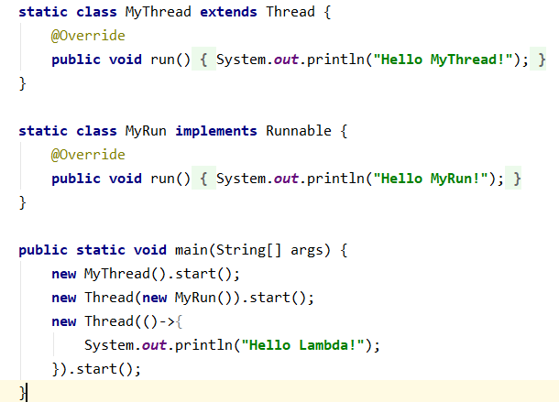
Thread
Why need multi-thread?
Program response quickly
How create thread?

Slide 5
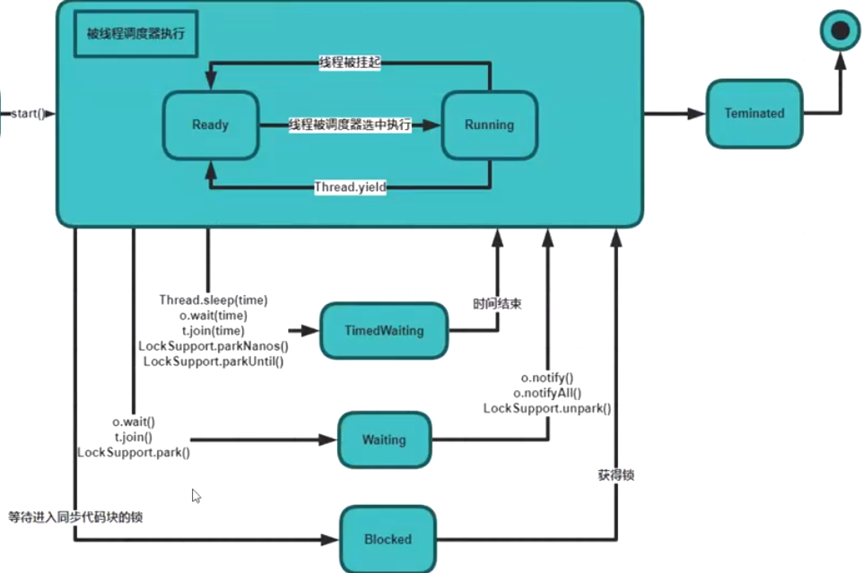
Thread
Thread state
Sleep
Yield
Join
Wait
Notify

Slide 6
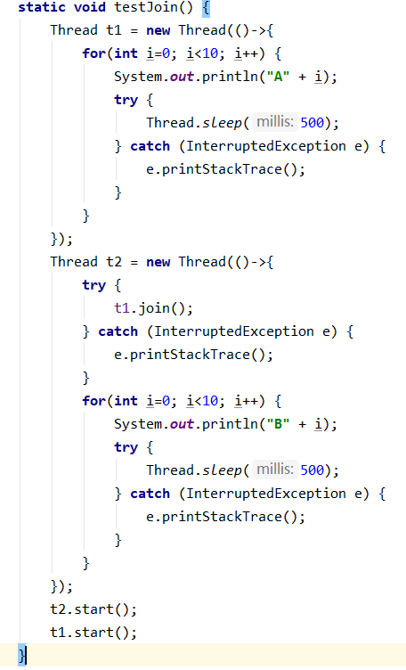

Thread
QA : How make thread A,B,C sequential execution?

Slide 7
Thread
Problem of multi-thread?
Sharing data between threads causes concurrency problems
How to solve this problem?
Thread one by one handle the sharing data

Slide 8
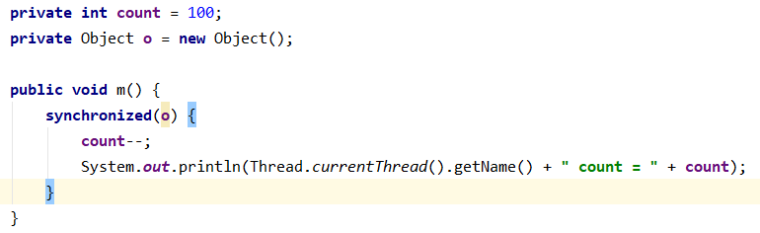
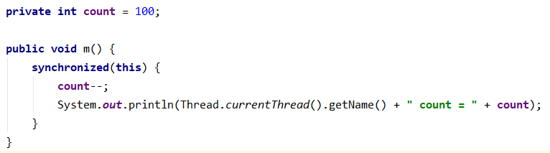
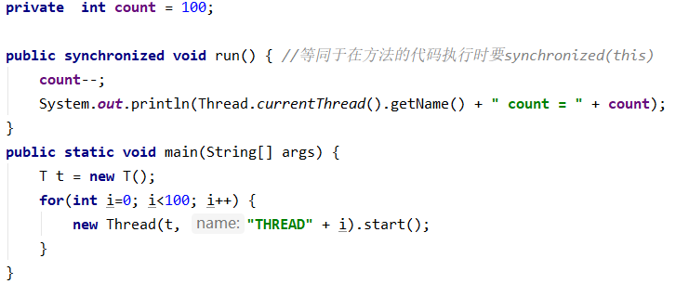
Lock
Synchronized : key word

Slide 9
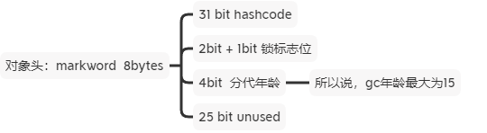
Lock
Synchronized
Principle

Slide 10
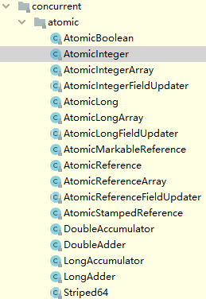
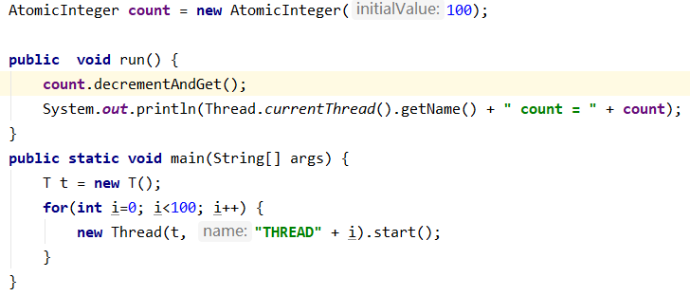
Lock
AtomicXXX

Slide 11
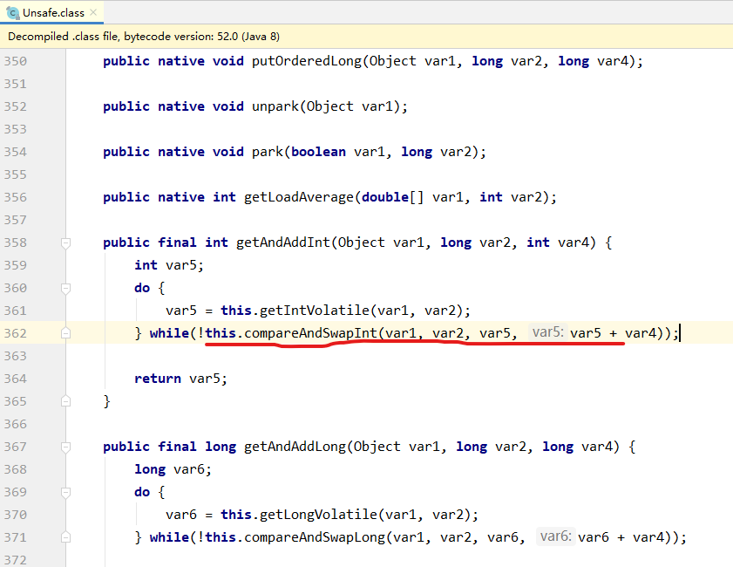
Lock
AtomicXXX
Principle
CAS(Compare And Swap/Set)
CAS(value,expectValue,newValue) if (v == exp) 【Step 1】v = nv 【Step 2】 else continue
Problem
ABA

Slide 12
Lock
JUC
ReentrantLock
ReadWriteLock
CountDownLatch
CyclicBarrier
Phaser
Semaphore
Exchanger
LockSupport

Slide 13
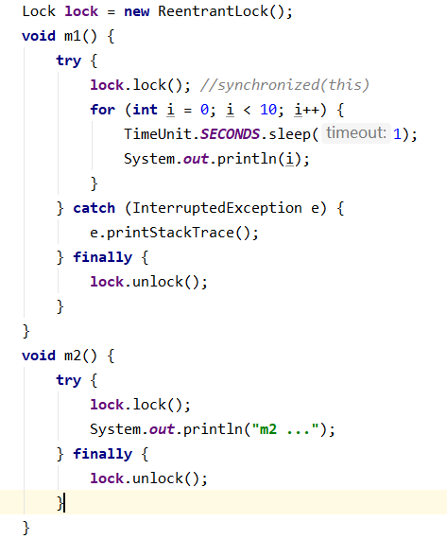
JUC
ReentrantLock

Slide 14
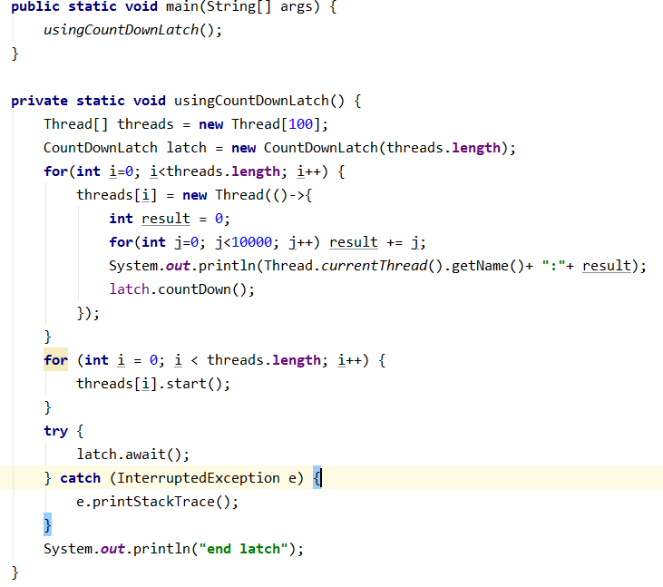
JUC
CountDownLatch

Slide 15
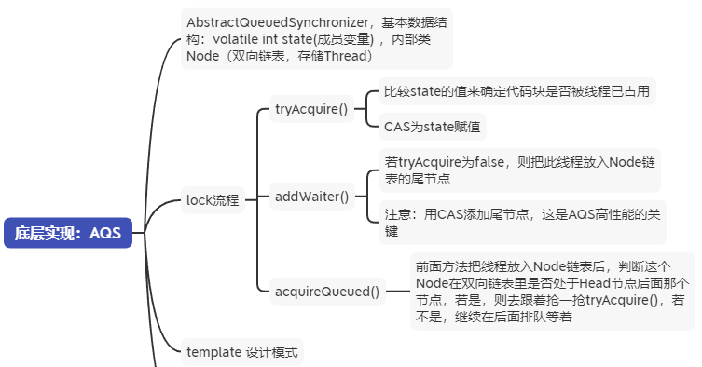
JUC
Principle

Slide 16
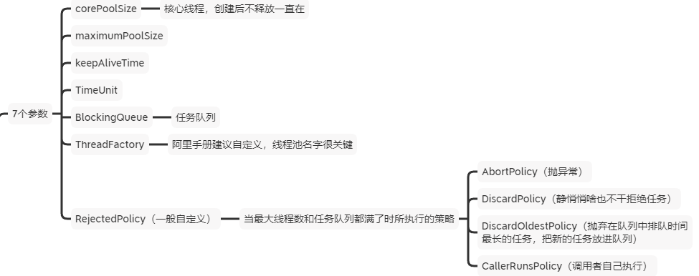
Thread Pool
What?
将线程和任务解耦，维护着两个集合，一个是线程集合，一个是任务集合，管理线程和任务
How create?

Slide 17
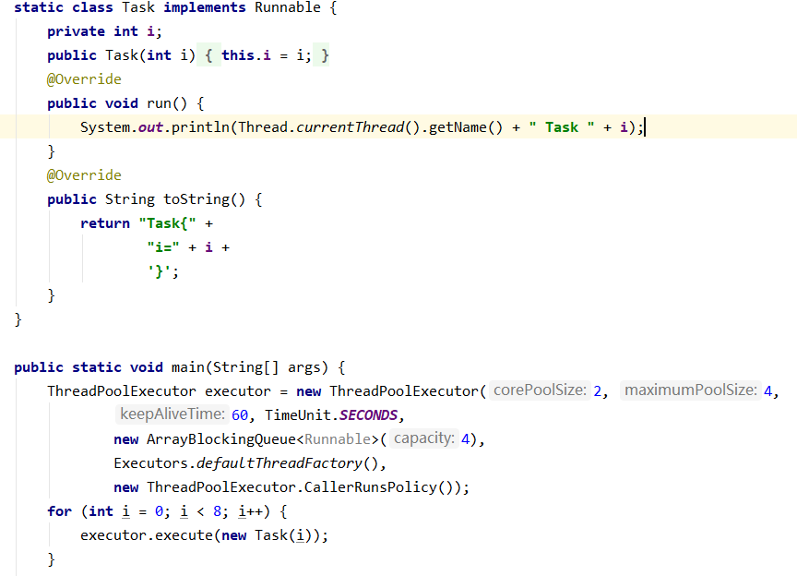
Thread Pool
Example

Slide 18
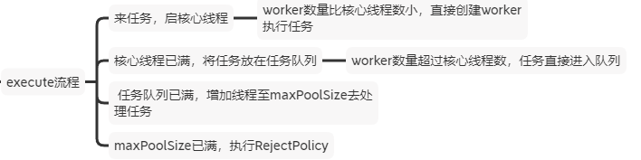
Thread Pool
Execute process

Slide 19

QA

Slide 20
End

